Slide 1
Amazon Stock Dataset Collection
Timothy Grashaw, Alex Litchfield, and Ruikang Lin

Slide 2

Question/Goal
Goal/Driver:
To identify stock price fluctuations or large shifts in trading volumes and determine if they correlate to specific company or market events
Mode of Collection:
Observation - collected by Yahoo Finance through different stock exchanges on a daily basis

Slide 3

Data Acquisition
The data is available on Kaggle for free. It was captured via different measurement processes at stock exchanges.
The data is compiled into the following fields:
date (specific trade date)
open (opening price)
high (maximum price during the day)
low (minimum price during the day)
close (close price adjusted for splits)
adj close (adjusted close price adjusted for both dividends and splits)
volume (the number of shares that changed hands during a given day)

Slide 4
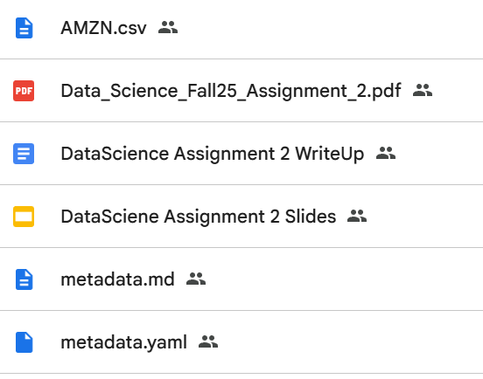
Organization
Stored on Google drive
Limited edit access
CSV format
Date | Open | High | Low | Close | Adj Close | Volume
1997-05-15 | 2.4375 | 2.5 | 1.927083373 | 1.958333373 | 1.958333373 | 72156000
1997-05-16 | 1.96875 | 1.979166627 | 1.708333373 | 1.729166627 | 1.729166627 | 14700000
1997-05-19 | 1.760416627 | 1.770833373 | 1.625 | 1.708333373 | 1.708333373 | 6106800
...
2020-03-30 | 1922.829956 | 1973.630005 | 1912.339966 | 1963.949951 | 1963.949951 | 6126100
2020-03-31 | 1964.349976 | 1993.02002 | 1944.01001 | 1949.719971 | 1949.719971 | 5123600
2020-04-01 | 1932.969971 | 1944.959961 | 1893 | 1907.699951 | 1907.699951 | 4111100
Notes:
This project is stored on a Google drive, allowing any viewers or collaborators to download. However, only the team members are allowed to edit. The logical collection for this project will consist of the Amazon daily stock trading dataset, organized as a single dataset with a consistent CSV structure (AMZN.csv). Overall, this structure of organization is accessible and convenient for the team members and is self-documenting and intuitive for viewers or collaborators.

Slide 5
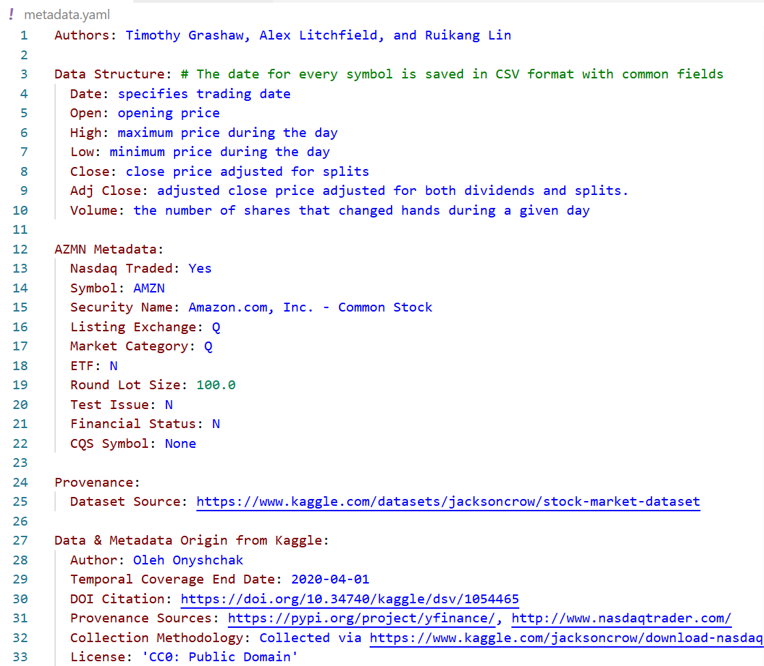
Metadata
YAML format
Self-documenting
Interoperability
Provenance will include any data processing
Notes:
The metadata for the dataset can be accessed through a yaml file stored in the Google drive. This includes authors, dataset structure, Amazon metadata, provenance, and any metadata derived from the origin. This format is self documenting, human readable, as well as machine readable. And any additional metadata will be included and any steps taken in the data processing will be stored in the provenance section.

Slide 6
Key Considerations
Data Ownership
Data Distribution and Publication
Security Support
Persistence
Interoperability Support
Notes:
Here are some key considerations. For “Data Ownership”, we credit the original author of the dataset in the metadata file. For “Data Distribution and Publication”, “Security Support” and “Persistence”, we set up our google drive folder where this collection is publicly viewable but restricts editing access to prevent unauthorized data modification or tampering. We store copies of the original dataset in the Google Drive, ensuring that the data has backups available if anything happen to the datasets on our local hard drives. For “Interoperability Support”, we keep the data in its original CSV file format, which is supported on many platforms. And therefore, keeping the overall collection simple and intuitive for any users and viewers.

